Slide 1
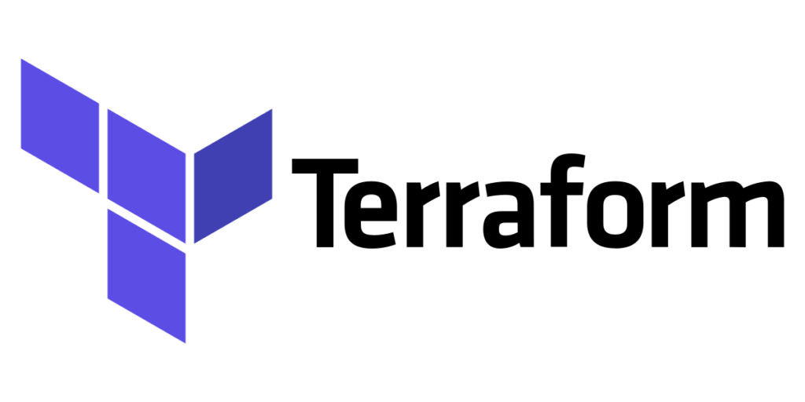


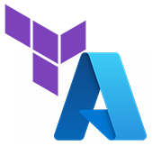
VMs and Load Balancer configuration

Slide 2
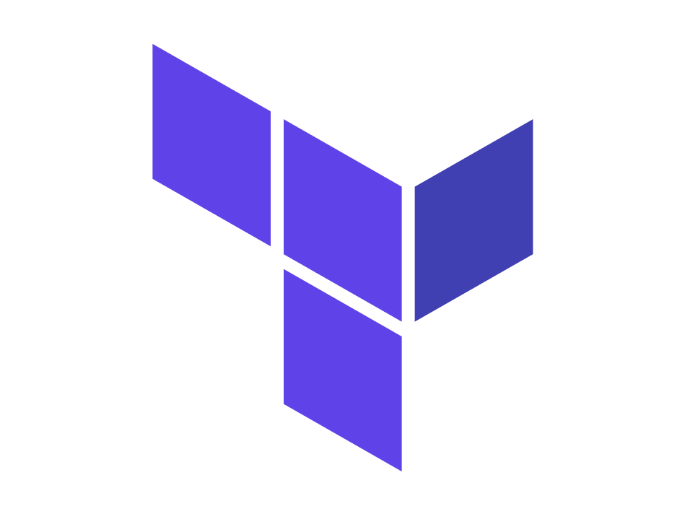

What it is Terraform and Azure
Terraform
Azure
Terraform is an infrastructure as code tool that lets you define both cloud and on-prem resources in human-readable configuration files that you can version, reuse, and share.
Azure is a cloud computing platform and an online portal that allows you to access and manage cloud services and resources provided by Microsoft.

Slide 3
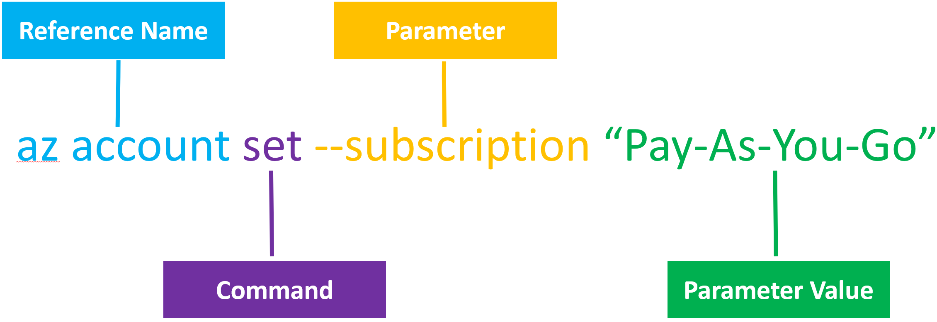
What is Azure CLI
Azure CLI
is a command-line tool to create and manage resources.
Azure CLI interacts with the Azure Resource Manager (ARM) service, which is the management layer to interact with resources in your account.

Slide 4
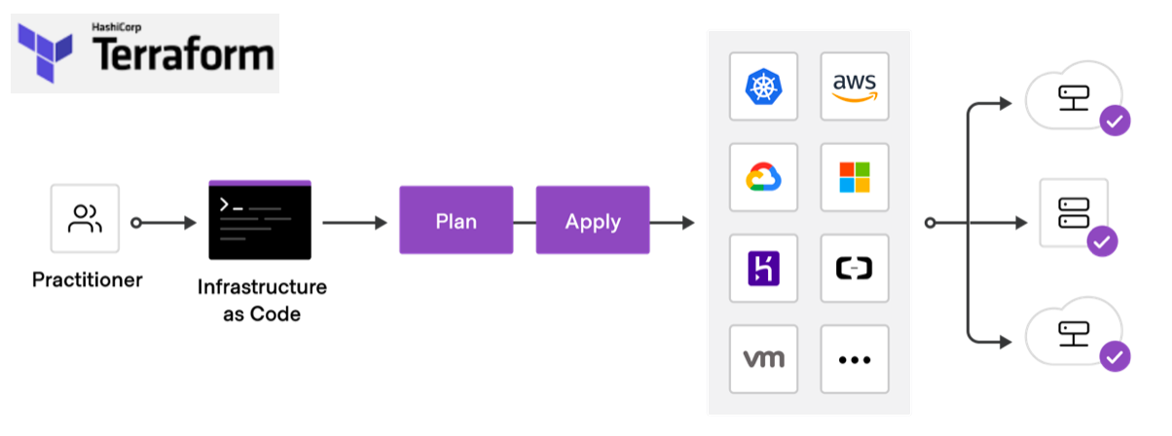
How Terraform works

Slide 5
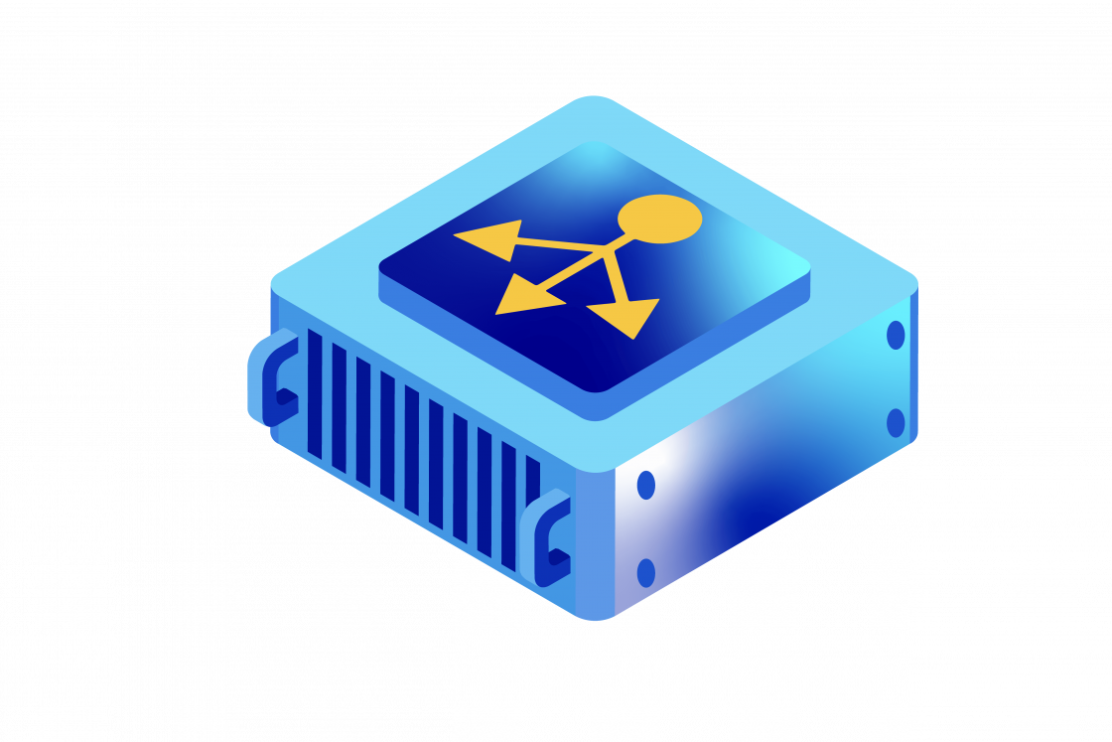
Azure key components
we will be configuring:
Virtual Machines
Load Balancer
Availability Set

Slide 6
Virtual Machines in Azure
Virtual Machines in Azure are scalable computing resources, that provide cloud-based virtualized hardware.
Flexible Operating System Options
Customizable VM Sizes
Autoscaling
Integrated Networking, Integration with Other Azure Services

Slide 7
Azure Load Balancer
Load distribution
Scalability
Load Balancer allows you to easily add or remove servers based on demand.
Redirects incoming traffic between multiple servers.
Fault Tolerance
High Availability
Load Balancer automatically redirects traffic to the remaining healthy nodes.
Ensures application availability by redirecting requests to available resources.
A load balancer is a cloud service that automatically distributes traffic between virtual machines or other resources to ensure high availability and application performance.

Slide 8



How Backend Address Pool and Load Balancer work
Situation: Imagine a pizzeria with several cooks. Each of them can make pizza, but customers order pizza without knowing which cook will make it. Your goal is to distribute the orders evenly so that each cook is loaded as equally as possible.
Load balancer
Backend address pool
The balancer knows all the cooks and can send an order to any of them to cook your pizza.
is an order dispatcher that takes all the orders and decides which cook to send the next order to.
is a group of cooks working in a pizzeria.
Delicious example

Slide 9
Availability sets
Availability sets are logical groupings of VMs that reduce the chance of correlated failures bringing down related VMs at the same time.
Fault Domains
Update Domains
are logical groups of virtual machines that can be updated or rebooted separately from others.
are logical groups that represent physical areas of failure, such as racks of servers that share power and network infrastructure.
The maximum number
of Fault Domains in Azure is 3.
By default, Azure provides 5 Update Domains, but their number can be configured up to 20.

Slide 10
Main Azure CLI commands
Sign in to your Azure account
az login
Creating a resource
az group create --name myResourceGroup --location eastus
View a list of resource groups
az group list --output table
Creating a virtual machine
az vm create --resource-group myResourceGroup --name myVM --image UbuntuLTS --admin-username azureuser --generate-ssh-keys
Stopping the virtual machine
az vm stop --resource-group myResourceGroup --name myVM
List of resources in the group
az resource list --resource-group myResourceGroup --output table
https://learn.microsoft.com/en-us/cli/azure/

Slide 11
Azure CLI commands to create resources
Сreate a virtual machine
az vm create \
--resource-group myResourceGroup \
--name myVM \
--image UbuntuLTS \
--admin-username azureuser \
--generate-ssh-keys
Create a load balancer
az network lb create \
--resource-group myResourceGroup \
--name myLoadBalancer \
--public-ip-address myPublicIP \
--frontend-ip-name myFrontEnd \
--backend-pool-name myBackEndPool
Create an availability set
az vm availability-set create \
--resource-group myResourceGroup \
--name myAvailabilitySet \
--platform-fault-domain-count 2 \
--platform-update-domain-count 5 \
--location eastus

Slide 12


Install Terraform and Azure CLI
Terraform
https://developer.hashicorp.com/terraform/install
The latest version: 1.9.6
Azure CLI
https://learn.microsoft.com/en-us/cli/azure/install-azure-cli
The latest version: 2.64.0

Slide 13
An example of how the load balancer works in Azure
1. Initial configuration
2. Problem: increasing load
3. Solution with Azure Load Balancer
You have one Windows VM with an installed product (for example, a web application) accessible to users via a public IP. This virtual machine is connected to Azure Load Balancer.
The site becomes popular, and a large number of users visit it, which leads to the fact that one virtual machine cannot cope with requests.
In order for the load balancer to effectively distribute requests and improve performance, you need to perform several step:
Adding additional virtual machines.
Traffic distribution.
4. Load balancer operation process
5. Result
When a user sends a request to the site (for example, tries to access the UI), the request goes to the Azure Load Balancer.The balancer redirects the request to one of the available virtual machines in the pool.
Instead of one overloaded virtual machine, the traffic is now distributed among several VMs. In case of increased load, you can easily add more virtual machines to the backend pool.
Azure Load Balancer

Slide 14
Case 1
Let's say you have a web application that runs on multiple virtual machines, and you want to make it available even in case of failure or maintenance. You can create an Availability Set for these VMs, which will allow you to distribute them across Fault Domains and Update Domains, ensuring availability balance.
2. Adding virtual machines:
1. Creation of
Availability Set
3. Operation during failure or update
When you add virtual machines to an Availability Set, Azure automatically allocates them to Fault and Update Domains. For example, if you have 6 virtual machines (VM1, VM2, ..., VM6), Azure will distribute them like this:
Fault Domain 1: VM1, VM2, VM3
Fault Domain 2: VM4, VM5, VM6
Each machine will also be distributed across Update Domains. For example:
Update Domain 1: VM1, VM4
Update Domain 2: VM2, VM5
Update Domain 3: VM3, VM6
Create an Availability Set and configure the number of Fault Domains and Update Domains. (for example, 2 Fault Domains and 3 Update Domains)
Failure: If one of the Fault Domains fails, the virtual machines in the other Fault Domain will remain active. This way, your app will continue to work.
Updates: When Azure performs maintenance, such as software updates, it does so consistently for each Update Domain.
Availability Set example

Slide 15
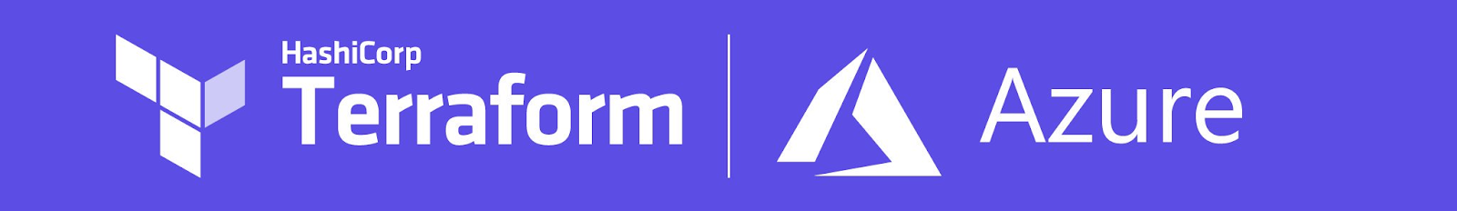
Homework
01
Prepare a Terraform config which will deploy a load balancer and availability set.
02
Prepare a Terraform config which will deploy two Linux VMs to the network. VMs should be connected to the load balancer.
03
Note: all configs from current homework should be saved to one place and be able to be executed by one Terraform command.
04
Save the configs to your GitHub repo.

Slide 16
Additional materials
Begin your Azure CLI journey
How to create availability set
https://learn.microsoft.com/en-us/cli/azure/get-started-tutorial-0-before-you-begin
https://www.softnas.com/docs/softnas/v3/html/azure_availability_sets.html
How to install Terraform
Create your first Azure VM instance using Terraform
https://www.youtube.com/watch?v=dA6WqakJOts
https://avabodha.in/create-your-first-azure-virtual-machine-instance-using-terraform/

Slide 17
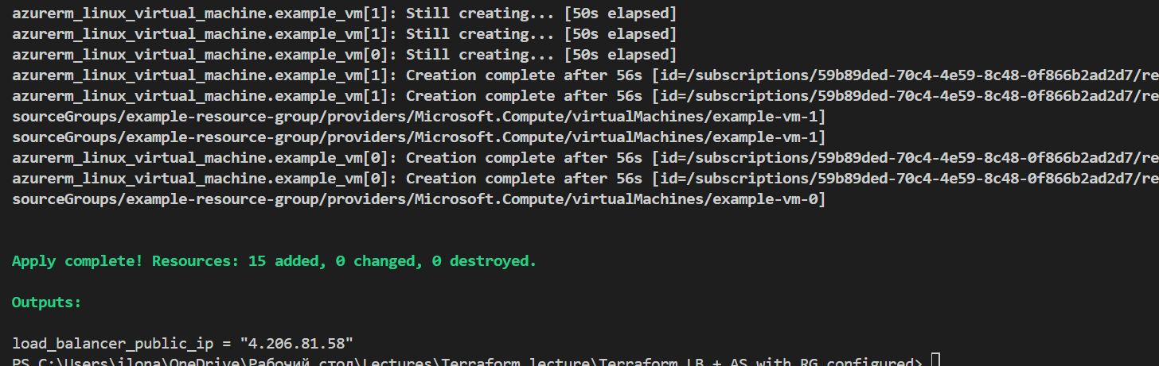
Successful execution of Terraform script

Slide 18
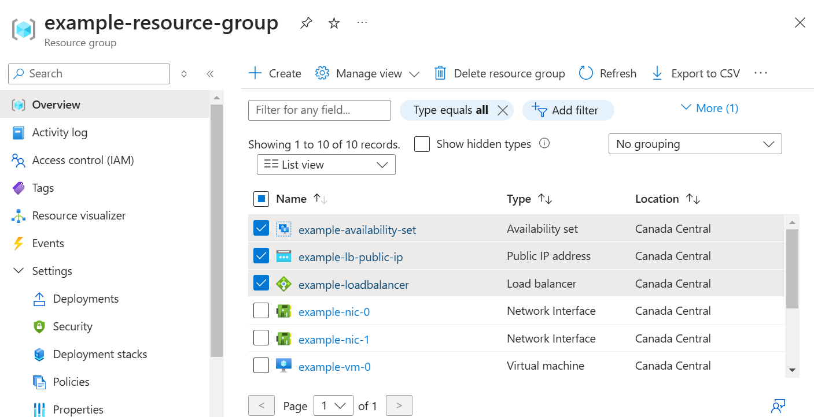
Created resources after execution of Terraform script

